Slide 1
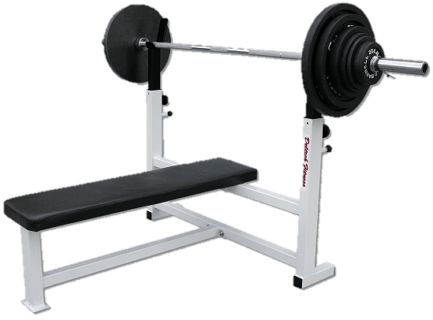
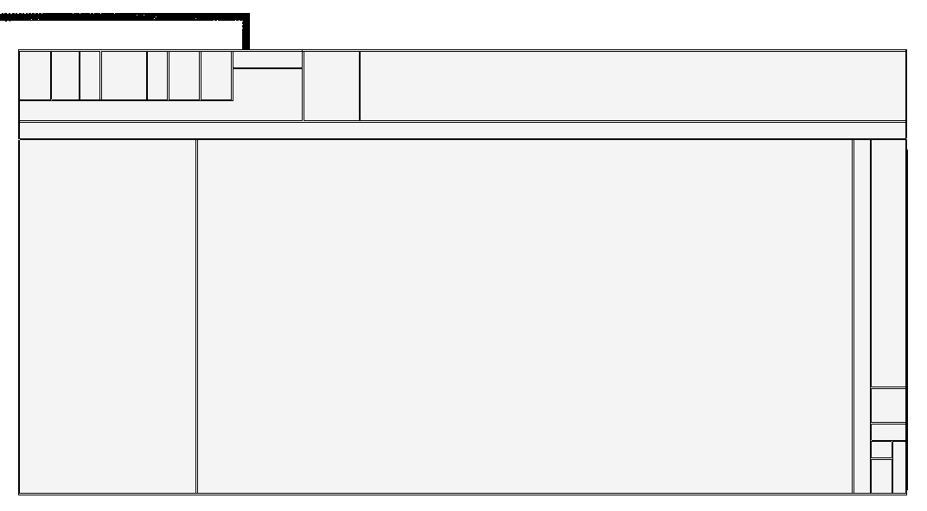
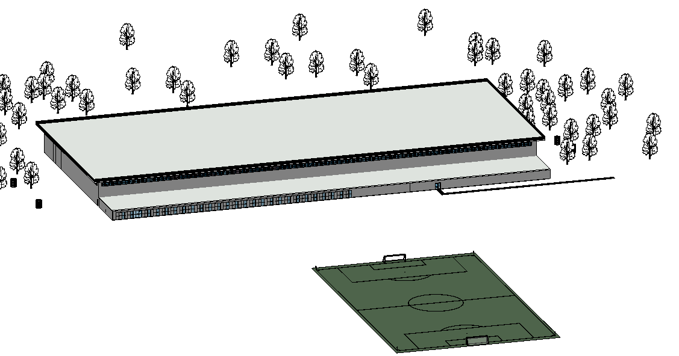
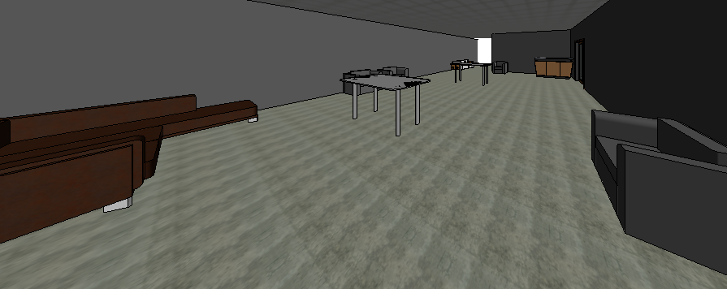
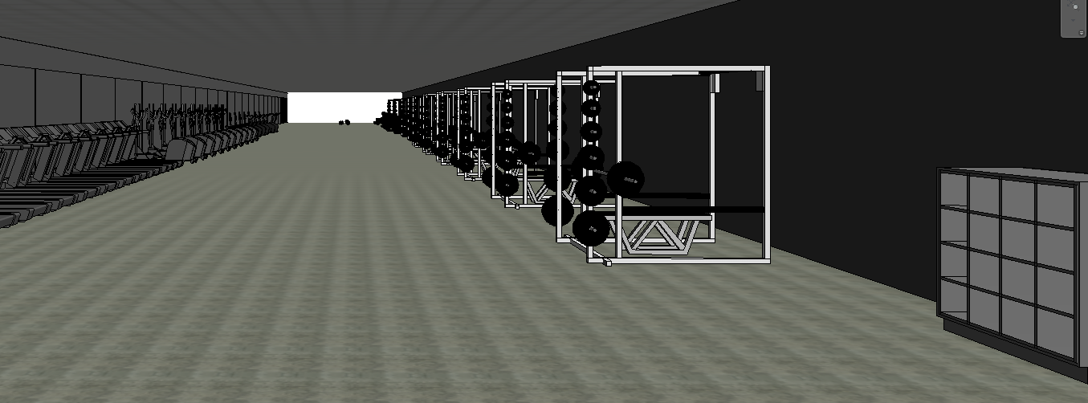
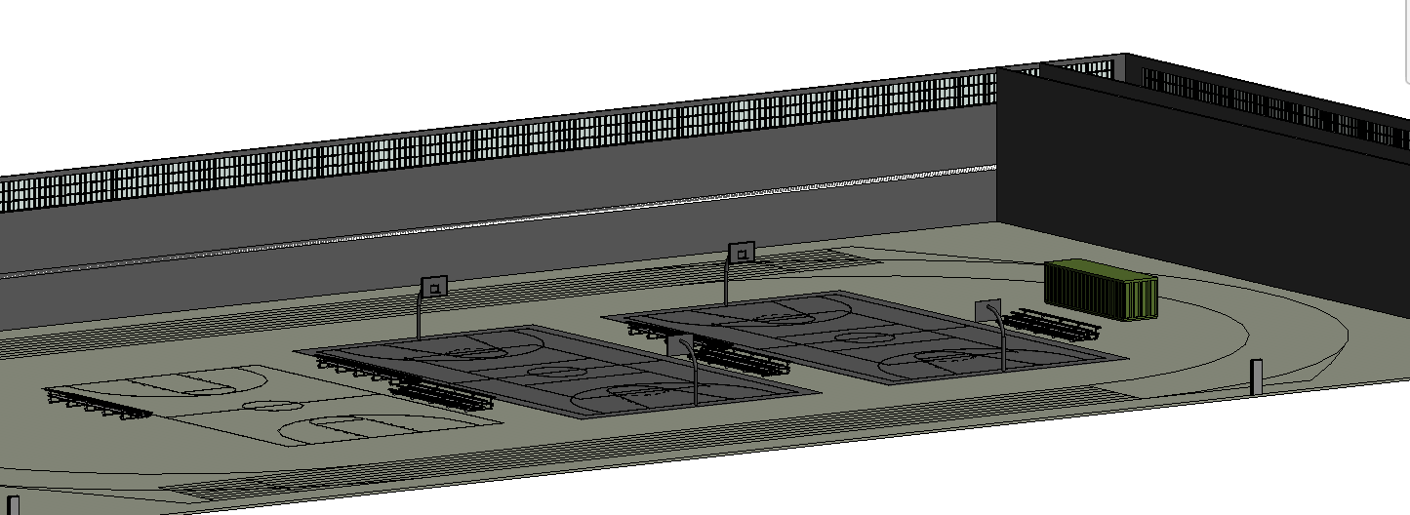
Elizabethtown College: Wellness Center
Team Members: Luke Yanek, Andres Hartman, Eric Borkowicz
Introduction
Site Design
Interior Design
LEED Credentials
Quality experience in and out of classroom.
Athletic facilities have fallen below standards.
Campus currently offers medical care, wellness education, intramurals and group fitness classes
Body shop and Athlete Gym are underequipped for the large amount of student use
1968 Thompson Gym supported 10 Varsity teams Thompson Gym now supports 22 sports teams
400 athletes share 8 locker rooms
Embrace student’s interest in physical wellbeing
South of the Ira R. Herr Soccer Field
Able to support NCAA regulation indoor track
700 students live in the quads, apartments and founders
800 students live in remaining dormitories
The wellness center will be very close to half of the campus housing, mainly upper classman
Can serve as starting point to expand and add more dormitories behind it
Soccer, baseball and softball fields are in close proximity to the facility
5 functional areas, welcome area and two restrooms.
200 meter indoor track circling 3 full size basketball courts.
20,000 square foot additional program space
6 locker rooms with full shower and bathroom
Sports medicine facility
15,000 Sq. Ft. fitness center
Area for counselling and wellness education
Location is in a highly populated area
Minimal initial demolition is required
Native plants will be used on green roof
Rainwater management through green roof and permeable walkways
Gray water re-usage in bathroom facilities
Interior materials will have no VOCs
High windows and clear story for natural lighting
Eligible for LEED accreditation
.
Key Design Choices
1 story design
Green Roof
Permeable walkways
Smoothie bar
Variable sized locker rooms
Clear story with overhang
Regulation size indoor track
North facing double door system
.
Acknowledgments
A Special Thanks to:
Dr. Joseph Wunderlich Bill Sutton
Marianne Calenda Coach Schlosser
The Department of Engineering and Physics Elizabethtown College 2014

